Slide 1









Slide 3
Enter your details below
Your name
________________________
Name of your school
________________________
Male/Female
Date of Birth
________________________

Slide 4

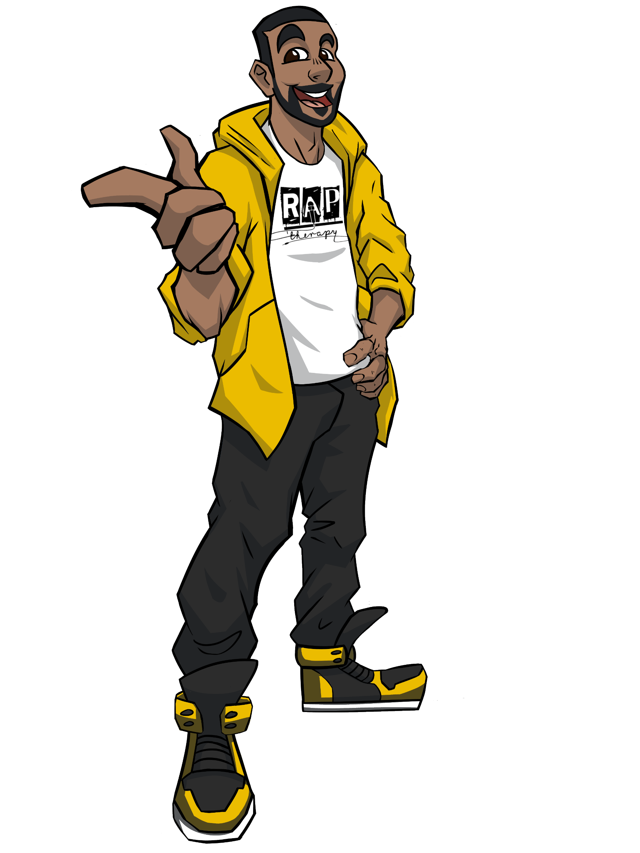
Hi there! My name is Proph and I am here to teach you how to rap!

Slide 5
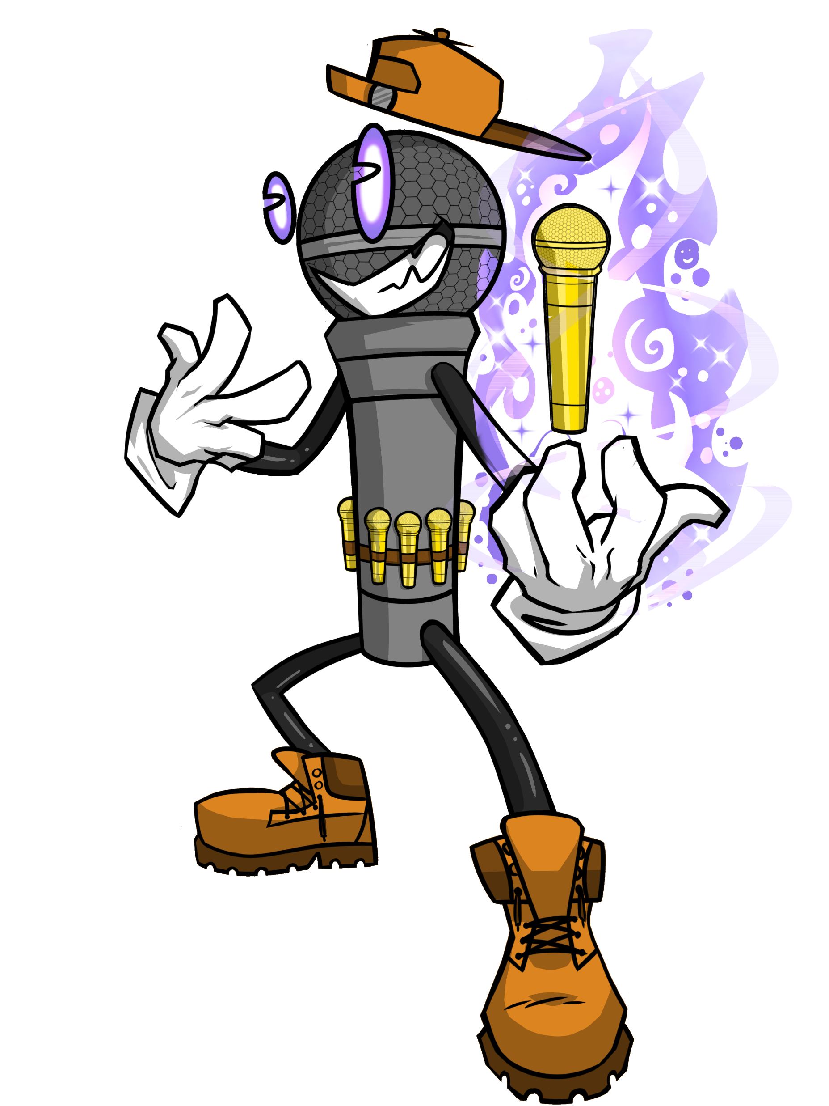

Throughout this journey, your goal is to collect
All 50 Mystic Mics!

Slide 6

Mystic Mics can be collected after completing different challenges.

Slide 7
But you need to watch out for The Mic Menace because he is evil and likes to steal microphones!

Slide 8

Oh no, here comes The Mic Menace. I better make a run for it!

Slide 9
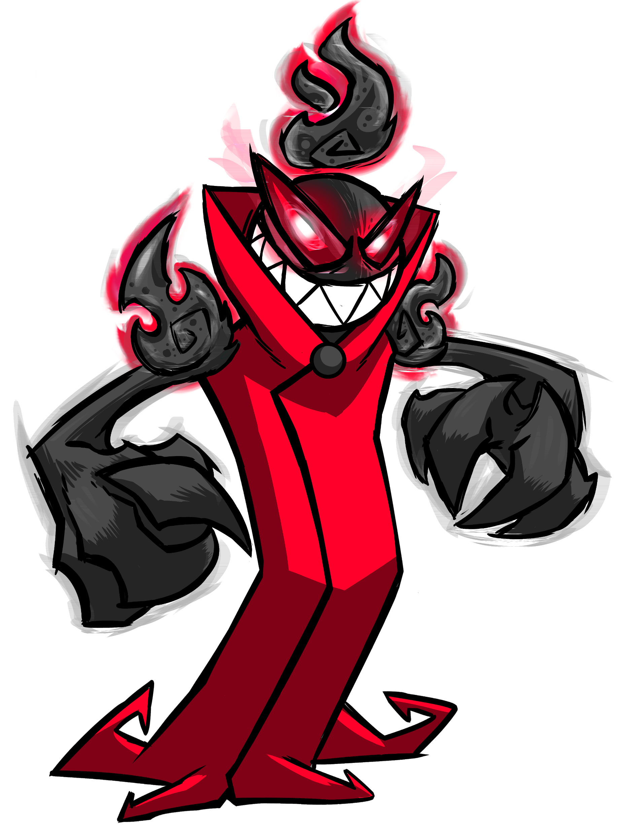
Ha ha ha, I’m The Mic Menace and I am here to steal your microphones!
Wait…
What’s this…you don’t have any microphones to steal yet?
Pathetic!
I guess I will be seeing you later!

Slide 10
Phew, that was close!
Sorry I had to jet. The Mic Menace is way too scary!
Where was I…

Slide 11

Throughout the game, you are going to see the below after specific games:
Right now I am feeling
1 2 3 4 5 6 7 8 9 10

Slide 12
1 is the lowest on the scale and 10 is the highest.
Example: If you are sad, you might put a 1 but if you are happy you might put a 10.
It is important that you are totally honest!
Right now I am feeling
1 2 3 4 5 6 7 8 9 10

Slide 13
Let’s give it a try!
Slide the cursor to the number that best matches how you are feeling
Right now I am feeling
1 2 3 4 5 6 7 8 9 10

Slide 14
Along the way, there may be some words that you might need the definition of, all you need to do is click on the blue word for the definition and an example!

Slide 15


A rap needs to
rhyme
so we are going to start with a game!
Click the following word to move on.

Slide 16
Rhyme
A rhyme is where two words (especially the ending of the word) sounds similar to each other.
For example: Car and far rhyme with each other because the endings of both make the same ‘ar’ sound.

Slide 17
Place the words in green underneath the word that you think it rhymes with
Fair
Sad
Nightmare
Mad
Glad
Pad
Chair
Share
Pair
Lad
Care
Dad

Slide 18

Well done!
Can you do it again, but this time beat the clock?
Bring it on!

Slide 19

Click the timer to begin!
Locked
Climb
Time
Knocked
Nine
Mine
Hopped
Shocked
Chopped
Shine
Divine
Rocked

Slide 20


Well done!
You have just obtained a Mystic Mic!
Click the following word to move on.

Slide 21
Obtain
Obtain means to get or secure something
For example: the human being had to obtain Mystical Mic to move forward in the game.

Slide 22
Right now I am feeling
1 2 3 4 5 6 7 8 9 10
Slide the cursor to show how you currently feel.

Slide 23

You have
1/50
Mystic Mics
To see how many Mystic Mics you have obtained,
look at the top of the screen!

Slide 24
You have
1/50
Mystic Mics
I’m going to pass the mic onto my good friend Rhyming Rebecca to explain what rhyme schemes are!

Slide 25
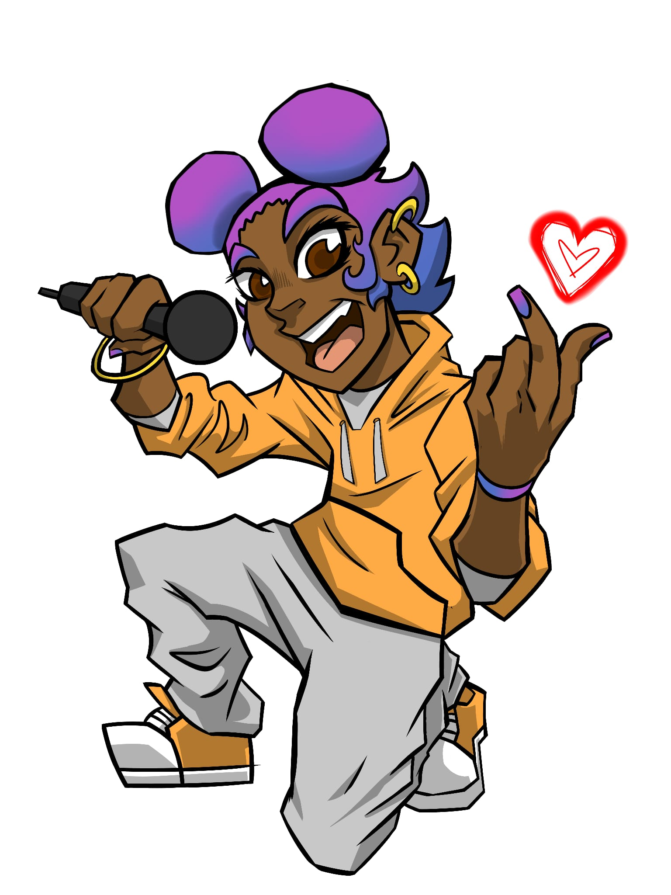
You have
1/50
Mystic Mics
Hey there…
My name is Rhyming Rebecca and I’m here to teach you about rhyme schemes.
There are loads of rhyme schemes, but on our journey, we only need to be aware of three!

Slide 26
You have
1/50
Mystic Mics
Rhyme Scheme
A rhyme scheme is a pattern that is followed throughout a rap. The rhyming words at the end of each line in a rap are what creates a rhyme schemes

Slide 27
AAAA
You have
1/50
Mystic Mics
AAAA is the first rhyme scheme
This is where all of the last words rhyme with each other.
Let’s look at an example on the next page.

Slide 28
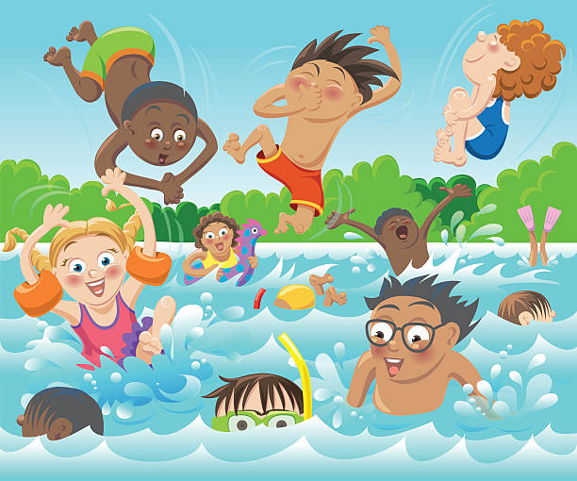
AAAA
You have
1/50
Mystic Mics
I woke up this morning feeling really cool
Every single day I have to go to school
I have loads of friends because I’m not cruel
And in the summer holidays we jump in a pool
Every single last word rhymes with each other so this would be called an A A A A rhyme scheme

Slide 29

Have a listen to the rap
You have
1/50
Mystic Mics
I woke up this morning feeling really cool
Every single day I have to go to school
I have loads of friends because I’m not cruel
And in the summer holidays we jump in a pool

Slide 30
Now try and rap along!
I woke up this morning feeling really cool

Slide 31
Now try and rap along!
Every single day I have to go to school

Slide 32
Now try and rap along!
I have loads of friends because I’m not cruel

Slide 33
Now try and rap along!
And in the summer holidays we jump in a pool

Slide 34
Well done, you have now learnt the rhyme scheme AAAA
You have just obtained a Mystic Mic!

Slide 35
You have
/50
Mystic Mics
2

Slide 36
AABB
You have
2/50
Mystic Mics
AABB is the second rhyme scheme
This is where the first two lines rhyme with each other and the last two lines rhyme with each other. Lines 1 and 2 do not rhyme with lines 3 and 4.
Let’s look at an example on the next page.

Slide 37
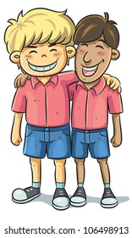
AABB
You have
2/50
Mystic Mics
Every single day I see my best friend
If we have a disagreement we will not pretend
We will talk it out if there’s an issue
And if he starts to cry, I’ll get him a tissue
The first two lines rhyme with each other and the last two lines rhyme with each other so this would be called an AABB rhyme scheme.

Slide 38
Have a listen to the rap
You have
2/50
Mystic Mics
Every single day I see my best friend
If we have a disagreement we will not pretend
We will talk it out if there’s an issue
And if he starts to cry, I’ll get him a tissue

Slide 39
Now try and rap along!
Every single day I see my best friend

Slide 40
Now try and rap along!
If we have a disagreement we will not pretend

Slide 41
Now try and rap along!
We will talk it out if there’s an issue

Slide 42
Now try and rap along!
And if he starts to cry, I’ll get him a tissue

Slide 43
Well done, you have now learnt the rhyme scheme AABB
You have just obtained a Mystic Mic!

Slide 44
You have
/50
Mystic Mics
3

Slide 45
ABAB
You have
3/50
Mystic Mics
ABAB is the third rhyme scheme
This is where the first line rhymes with the third line and the second line rhymes with the fourth line.
Let’s look at an example on the next page.

Slide 46
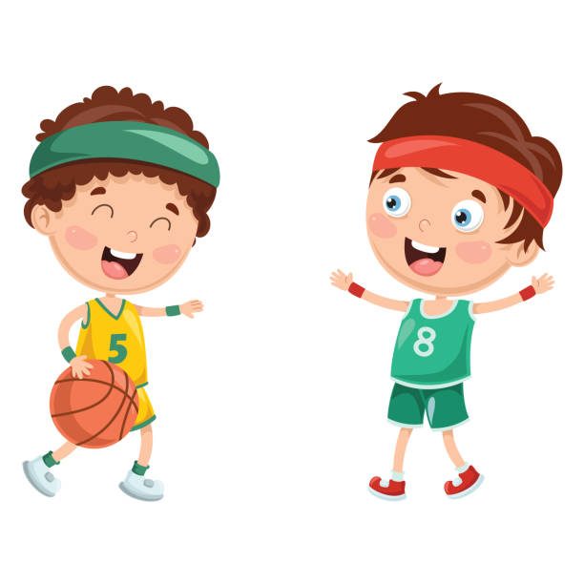
ABAB
You have
3/50
Mystic Mics
I was sitting on a stall
I was waiting for my friend
My friend he’s so cool
Our friendship will never end
The first line and the third line rhyme with each other and the second line and the fourth line rhyme with each other so this would be called an ABAB rhyme scheme.

Slide 47
Have a listen to the rap
You have
3/50
Mystic Mics
I was sitting on a stall
I was waiting for my friend
My friend he’s so cool
Our friendship will never end

Slide 48
Now try and rap along!
I was sitting on a stall

Slide 49
Now try and rap along!
I was waiting for my friend

Slide 50
Now try and rap along!
My friend he’s so cool

Slide 51
Now try and rap along!
Our friendship will never end

Slide 52
Well done, you have now learnt the rhyme scheme ABAB
You have just obtained a Mystic Mic!

Slide 53
You have
/50
Mystic Mics
4

Slide 54
Right now I am feeling
1 2 3 4 5 6 7 8 9 10
Slide the cursor to show how you currently feel.

Slide 55
You have
4/50
Mystic Mics
You now have to listen the rap clips and choose which rhyme scheme you think is being used.

Slide 56
You have
4/50
Mystic Mics
Which rhyme scheme is being used?
Click the correct answer after you have listened to the audio
AAAA
AABB
ABAB

Slide 57
You have
4/50
Mystic Mics
Which rhyme scheme is being used?
Click the correct answer after you have listened to the audio
AAAA
AABB
ABAB

Slide 58
You have
4/50
Mystic Mics
Which rhyme scheme is being used?
Click the correct answer after you have listened to the audio
AAAA
AABB
ABAB

Slide 59
You have
4/50
Mystic Mics
Which rhyme scheme is being used?
Click the correct answer after you have listened to the audio
AAAA
AABB
ABAB

Slide 60
You have
4/50
Mystic Mics
Which rhyme scheme is being used?
Click the correct answer after you have listened to the audio
AAAA
AABB
ABAB

Slide 61
Well done!
You have just obtained a Mystic Mic!

Slide 62
You have
/50
Mystic Mics
5

Slide 63
You have
5/50
Mystic Mics
You will now have to insert these words to make a 16 bar rap.
The rap needs to make sense and you must follow the AAAA rhyme scheme!

Slide 64
You have
5/50
Mystic Mics
16 bar
A bar is a single line in a rap.
For example:
I woke up this morning feeling really cool (one bar)
Every single day I have to go to school (this line with the above line makes two bars)
I have loads of friends because I’m not cruel (this line with the previous two bars makes three bars)
And in the summer holidays we jump in a pool (this line with the previous three bards makes four bars)

Slide 65
Right now I am feeling
1 2 3 4 5 6 7 8 9 10
Slide the cursor to show how you currently feel.

Slide 66
I was sitting in my _______
Looking at my socks, I had an odd ______
Some might think this is a ___________
However, me, I just didn’t ____________
I was feeling ________
I was chilling and relaxing, I didn’t feel _______
Watching my TV then in walks my _______
He said to me “you’re such a cool ________”
I looked at the clock and realised the _________
Big hand on the 12, small hand on the ________
Out came the sun, it started to _________
I ate up my cereal it tasted ___________
The cereal was delicious, I was so __________
I walked to my door because somebody ______________
Unlocked the door because it was ____________
Hey, it’s rapping rabbit, he hopped and he __________
Complete the 16 bar rap using the AAAA rhyme scheme
You have
5/50
Mystic Mics
Divine
Care
Glad
Dad
Hopped
Lad
Mad
Knocked
Shine
Locked
Nine
Shocked
Pair
Chair
Time
Nightmare

Slide 67
Right now I am feeling
1 2 3 4 5 6 7 8 9 10
Slide the cursor to show how you currently feel.

Slide 68
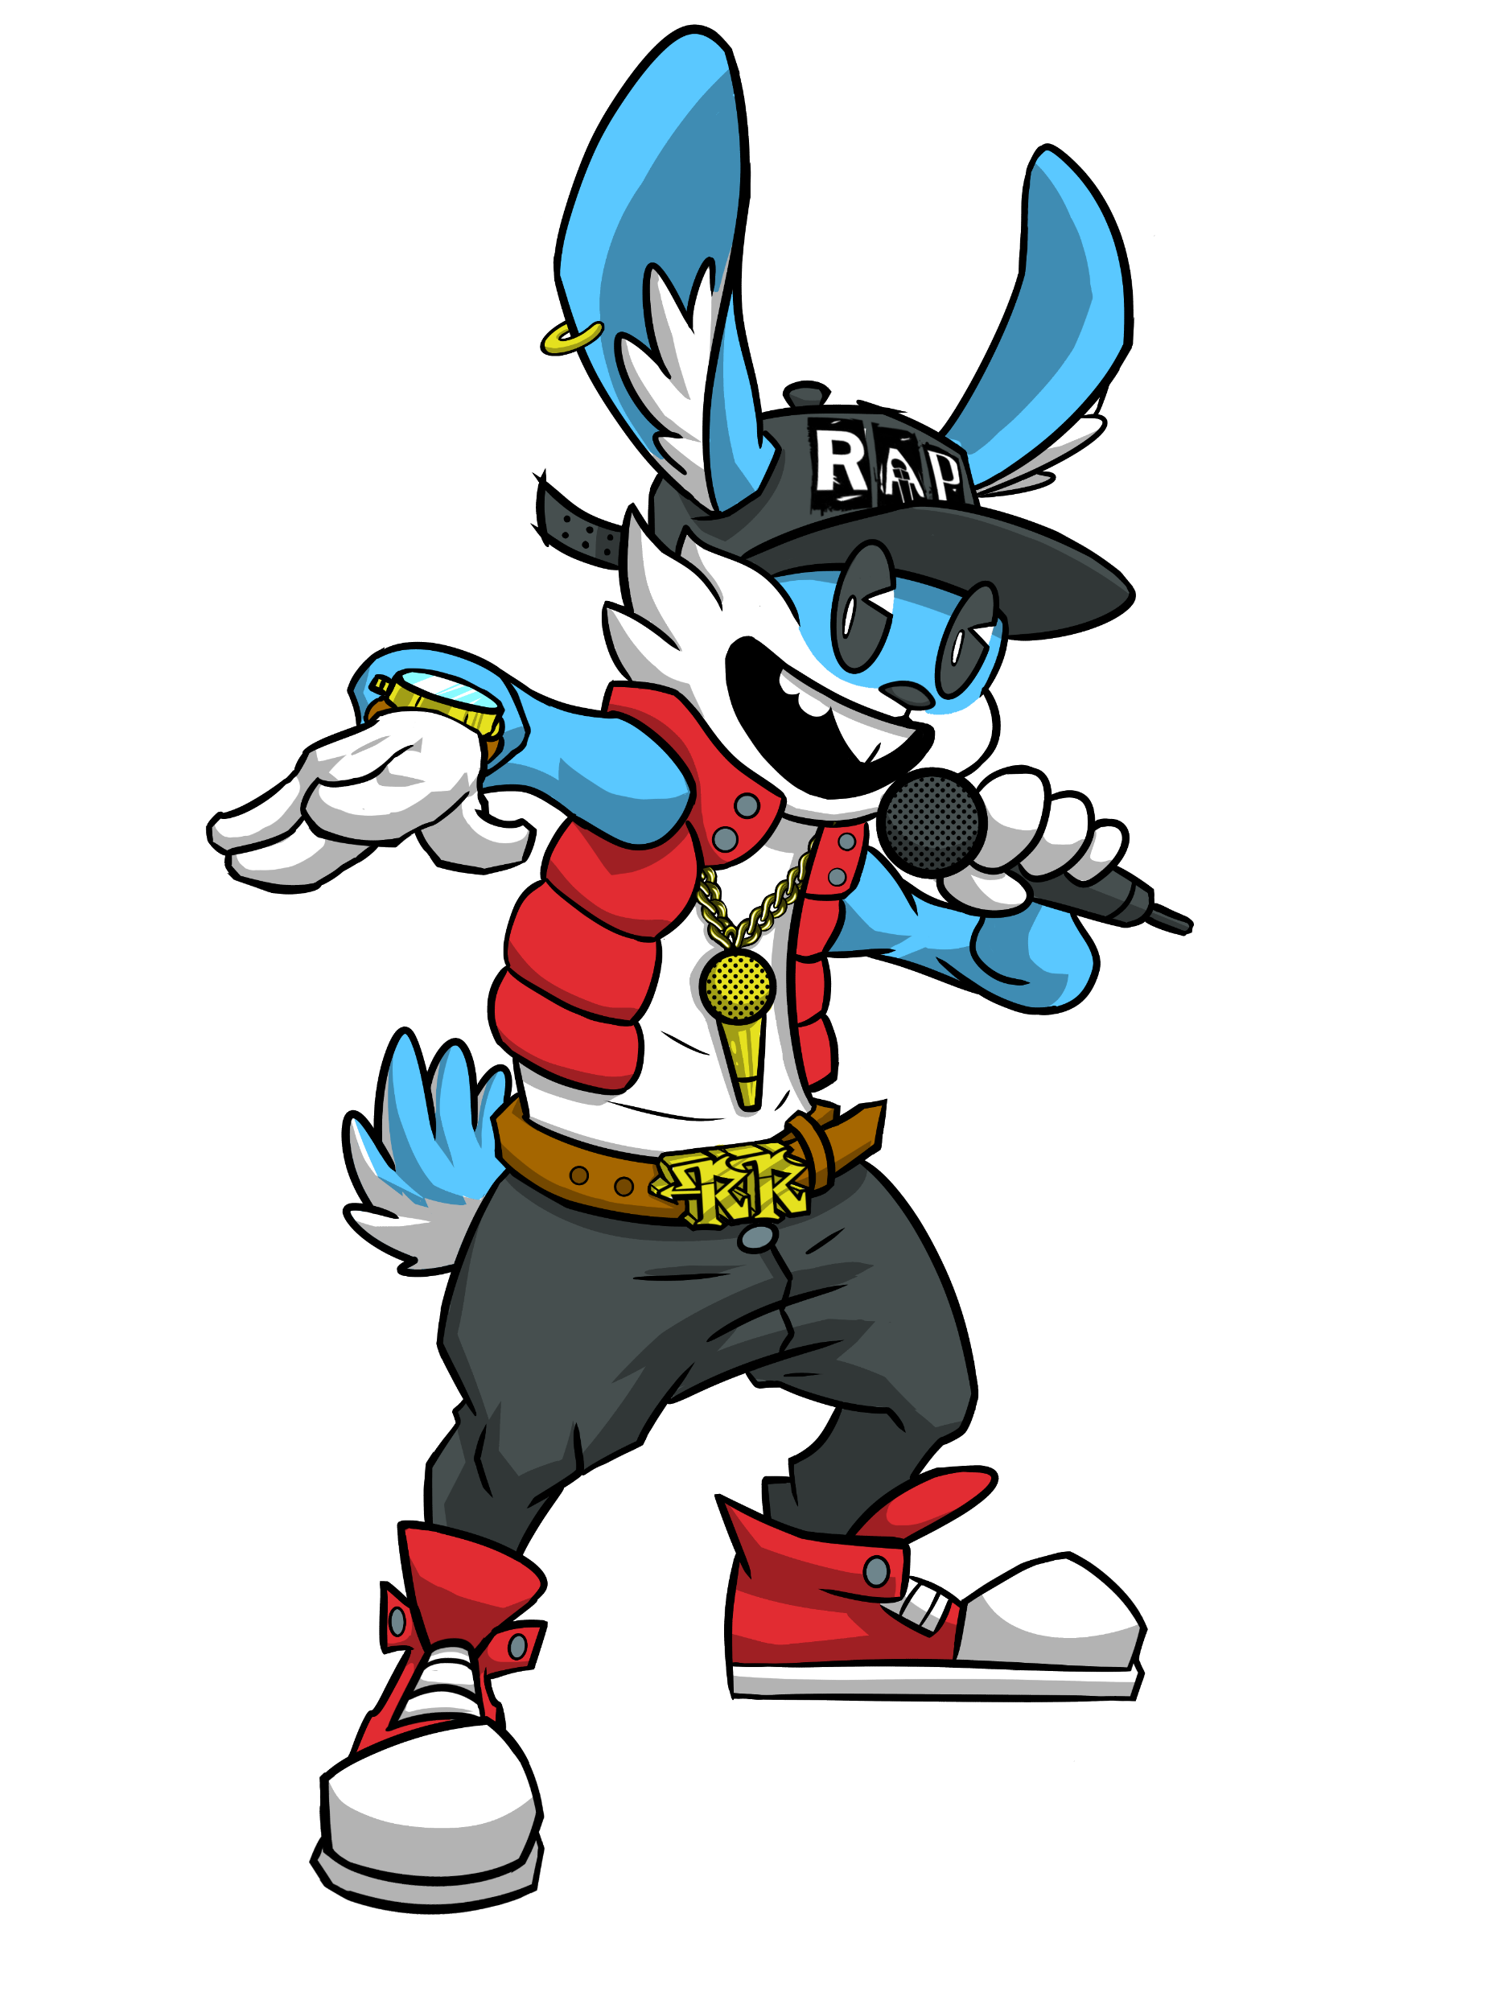
Well done!
You have unlocked one of my good friends Rapping Rabbit!
Rapping Rabbit only appears a few times on our journey and he gives you 5 Mystic Mics
You have
5/50
Mystic Mics

Slide 69
Rap along to the song!
You have
5/50
Mystic Mics
I was sitting in my chair
Looking at my socks, I had an odd pair
Some might think this is a nightmare
However, me, I just didn’t care

Slide 70
Rap along to the song!
You have
5/50
Mystic Mics
I was feeling glad
I was chilling and relaxing, I didn’t feel mad
Watching my TV then in walks my dad
He said to me “you’re such a cool lad”

Slide 71
Rap along to the song!
You have
5/50
Mystic Mics
I looked at the clock and realised the time
Big hand on the 12, small hand on the nine
Out came the sun, it started to shine
I ate up my cereal it tasted divine

Slide 72
Rap along to the song!
You have
5/50
Mystic Mics
The cereal was delicious, I was so shocked
I walked to my door because somebody knocked
Unlocked the door because it was locked
Hey, it’s rapping rabbit, he hopped and he hopped

Slide 73



Well done!
You have obtained 5 Mystic Mics from Rapping Rabbit
You have
5/50
Mystic Mics

Slide 74
Well done!
You have obtained 5 Mystic Mics from Rapping Rabbit
You have
5/50
Mystic Mics

Slide 75
You have
/50
Mystic Mics
10

Slide 76
Wow!
Thanks for that Rhyming Rebecca.
No worries Proph,
I’m going to pass the Mic back to you!

Slide 77
Good luck on your journey!

Slide 78
Let’s see if we can write some raps about different emotions

Slide 79
Pick an emotion to write a rap about.
Happy
Proud
Sad
Excited
Angry

Slide 80
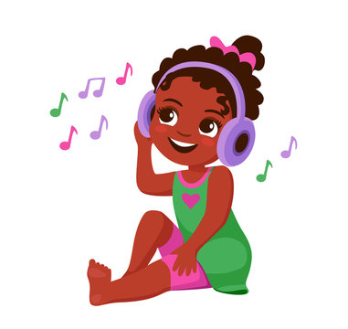
You have
10/50
Mystic Mics
Happy
When I’m listening to music I feel really ___________
It always calms me down so I don’t feel ____________
Dancing everywhere I dance around ______________
Music in my ears I can never feel ____________
down
snappy
happy
town

Slide 81
Well done! You have completed the rap.
I would now like you to rap along.
This time, you won’t hear my voice and you have to try and do it to the beat

Slide 82
You have
10/50
Mystic Mics
Happy
When I’m listening to music I feel really happy
It always calms me down so I don’t feel snappy
Dancing everywhere I dance around town
Music in my ears I can never feel down

Slide 83
You have
10/50
Mystic Mics
Which rhyme scheme is being used?
When I’m listening to music I feel really happy
It always calms me down so I don’t feel snappy
Dancing everywhere I dance around town
Music in my ears I can never feel down
AAAA
AABB
ABAB

Slide 84
Right now I am feeling
1 2 3 4 5 6 7 8 9 10
Slide the cursor to show how you currently feel.

Slide 85
Well done!
You have just obtained a Mystic Mic!

Slide 86
You have
/50
Mystic Mics
11

Slide 87
Pick an emotion to write a rap about.
Happy
Proud
Sad
Excited
Angry

Slide 88

You have
11/50
Mystic Mics
Proud
When I get a good grade, I feel really __________
The sky is really clear, there isn’t a dark ___________
If I’m really proud, I’m going to be ______________
But I won’t be boastful that isn’t really ___________
allowed
loud
Proud
cloud

Slide 89
Well done! You have completed the rap.
I would now like you to rap along.
This time, you won’t hear my voice and you have to try and do it to the beat

Slide 90
You have
11/50
Mystic Mics
Proud
When I get a good grade, I feel really proud
The sky is really clear, there isn’t a dark cloud
If I’m really proud, I’m going to be loud
But I won’t be boastful that isn’t really allowed

Slide 91
You have
11/50
Mystic Mics
Which rhyme scheme is being used?
When I get a good grade, I feel really proud
The sky is really clear, there isn’t a dark cloud
If I’m really proud, I’m going to be loud
But I won’t be boastful that isn’t really allowed
AAAA
AABB
ABAB

Slide 92
Right now I am feeling
1 2 3 4 5 6 7 8 9 10
Slide the cursor to show how you currently feel.

Slide 93
Well done!
You have just obtained a Mystic Mic!

Slide 94
You have
/50
Mystic Mics
12

Slide 95
Pick an emotion to write a rap about.
Happy
Proud
Sad
Excited
Angry

Slide 96
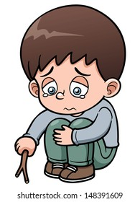
You have
12/50
Mystic Mics
Sad
I know it’s okay if sometimes I feel __________
It’s okay because it won’t last ___________
Feeling down doesn’t make me ______________
Keep looking at the bright side I’m still very ___________
clever
forever
bad
sad

Slide 97
Well done! You have completed the rap.
I would now like you to rap along.
This time, you won’t hear my voice and you have to try and do it to the beat

Slide 98
You have
12/50
Mystic Mics
Sad
I know it’s okay if sometimes I feel sad
It’s okay because it won’t last forever
Feeling down doesn’t make me bad
Keep looking at the bright side I’m still very clever

Slide 99
You have
12/50
Mystic Mics
Which rhyme scheme is being used?
I know it’s okay if sometimes I feel sad
It’s okay because it won’t last forever
Feeling down doesn’t make me bad
Keep looking at the bright side I’m still very clever
AAAA
AABB
ABAB

Slide 100
Right now I am feeling
1 2 3 4 5 6 7 8 9 10
Slide the cursor to show how you currently feel.

Slide 101
Well done!
You have just obtained a Mystic Mic!

Slide 102
You have
/50
Mystic Mics
13

Slide 103
Pick an emotion to write a rap about.
Happy
Proud
Sad
Excited
Angry

Slide 104
Let’s up the challenge

Slide 105

You have
13/50
Mystic Mics
Excited
When I go to my friend’s house I feel really _________
Every time we meet, I feel really ___________
When we play our games, he always makes a funny __________
I put my shoes on, do my lace and we __________
Excited
race
face
delighted

Slide 106
You have
13/50
Mystic Mics
Excited
When I go to my friend’s house I feel really excited
Every time we meet, I feel really delighted
When we play our games, he always makes a funny face
I put my shoes on, do my lace and we race
Click on the blue line!

Slide 107
You have
13/50
Mystic Mics
Internal rhyme
An internal rhyme is
where two or more words rhyme in the same line
Say the definition out loud
Did you notice that the definition of an ‘internal rhyme’ is an internal rhyme!

Slide 108
You have
13/50
Mystic Mics
Internal rhyme
Where…
Two or more words rhyme in the same line.
‘Rhyme’ and ‘line’ both rhyme with each other and they are in the same line
This is why the definition itself is an internal rhyme!

Slide 109
You have
13/50
Mystic Mics
Excited
When I go to my friend’s house I feel really excited
Every time we meet, I feel really delighted
When we play our games, he always makes a funny face
I put my shoes on, do my lace and we race
Click on the internal rhyme

Slide 110
Right now I am feeling
1 2 3 4 5 6 7 8 9 10
Slide the cursor to show how you currently feel.

Slide 111
Well done!
You have obtained 5 Mystic Mics from Rapping Rabbit
You have
13/50
Mystic Mics

Slide 112
Well done!
You have obtained 5 Mystic Mics from Rapping Rabbit
You have
13/50
Mystic Mics

Slide 113
You have
/50
Mystic Mics
18

Slide 114
Well done! You have completed the rap.
I would now like you to rap along.
This time, you won’t hear my voice and you have to try and do it to the beat

Slide 115
You have
18/50
Mystic Mics
Excited
When I go to my friend’s house I feel really excited
Every time we meet, I feel really delighted
When we play our games, he always makes a funny face
I put my shoes on, do my lace and we race

Slide 116
You have
18/50
Mystic Mics
Which rhyme scheme is being used?
When I go to my friend’s house I feel really excited
Every time we meet, I feel really delighted
When we play our games, he always makes a funny face
I put my shoes on, do my lace and we race
AAAA
AABB
ABAB

Slide 117
Right now I am feeling
1 2 3 4 5 6 7 8 9 10
Slide the cursor to show how you currently feel.

Slide 118
Well done!
You have just obtained a Mystic Mic!

Slide 119
You have
/50
Mystic Mics
19

Slide 120
Pick an emotion to write a rap about.
Happy
Proud
Sad
Excited
Angry

Slide 121
Let’s up the challenge

Slide 122
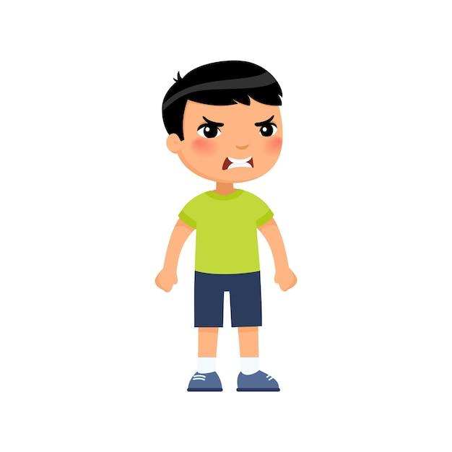
You have
19/50
Mystic Mics
Angry
Quite frankly, it’s ok to be ________
As long as I can express_________
Quite frankly it’s ok to be ____________
Writing rap is good for my mental __________
health
angry
myself
angry

Slide 123
You have
19/50
Mystic Mics
Angry
Quite frankly, it’s ok to be angry
As long as I can express myself
Quite frankly it’s ok to be angry
Writing rap is good for my mental health
Click on the blue line!

Slide 124
You have
19/50
Mystic Mics
Repetition
Repetition is where a line or a word is repeated more than once!
Repetition is where a line or a word is repeated more than once!
Repetition is where a line or a word is repeated more than once!
Say the definition three times out loud
You have just used repetition

Slide 125
You have
19/50
Mystic Mics
Angry
Quite frankly, it’s ok to be angry
As long as I can express myself
Quite frankly it’s ok to be angry
Writing rap is good for my mental health
Click on the repetition

Slide 126
You have
19/50
Mystic Mics
Angry
Quite frankly, it’s ok to be angry
As long as I can express myself
Quite frankly it’s ok to be angry
Writing rap is good for my mental health
Click on the internal rhyme

Slide 127
Right now I am feeling
1 2 3 4 5 6 7 8 9 10
Slide the cursor to show how you currently feel.

Slide 128
Well done!
You have obtained 5 Mystic Mics from Rapping Rabbit
You have
19/50
Mystic Mics

Slide 129
Well done!
You have obtained 5 Mystic Mics from Rapping Rabbit
You have
19/50
Mystic Mics

Slide 130
You have
/50
Mystic Mics
24

Slide 131
Well done! You have completed the rap.
I would now like you to rap along.
This time, you won’t hear my voice and you have to try and do it to the beat

Slide 132
You have
24/50
Mystic Mics
Which rhyme scheme is being used?
Quite frankly, it’s ok to be angry
As long as I can express myself
Quite frankly it’s ok to be angry
Writing rap is good for my mental health
AAAA
AABB
ABAB

Slide 133
Well done!
You have just obtained a Mystic Mic!

Slide 134
You have
/50
Mystic Mics
25

Slide 135
You have
25/50
Mystic Mics
You have now reached the halfway point…
Let’s play a game to see how much of a superstar rapper you have become!

Slide 136
You have
25/50
Mystic Mics
You will have 90 seconds to identify the internal rhyme in each part of the following rap!
Don’t worry…
you won’t have to cover the whole rap at the same time, you will have four bars come up at a time

Slide 137
The rap will play and you will listen and read along as the rap plays.
The game will then begin!
You have
25/50
Mystic Mics
It’s my fate, I know I’m great
I sleep early I don’t sleep late
So I’m always alert
When I play football I always have a messy shirt
I can be what I want when I’m older
Holding my controller I play games with composure
Sports person, e-gamer or a musician
Whatever I do I have to have a clear vision
I always have to keep the right crowd
When I make it I’ll make my family proud
Because I got vision and I make the right decision
I’m going to be great that’s what I envision
I make sure I’m always behaving
If I am behaving my life will be amazing
Hard work focus I’ll get what I want
Hard work focus I’ll get what I want

Slide 138
You have
25/50
Mystic Mics
Click on the internal rhyme
It’s my fate, I know I’m great
I sleep early I don’t sleep late
So I’m always alert
When I play football I always have a messy shirt

Slide 139
You have
25/50
Mystic Mics
Click on the internal rhyme
I can be what I want when I’m older
Holding my controller I play games with composure
Sports person, e-gamer or a musician
Whatever I do I have to have a clear vision

Slide 140
You have
25/50
Mystic Mics
Click on the internal rhyme
I always have to keep the right crowd
When I make it I’ll make my family proud
Because I got vision and I make the right decision
I’m going to be great that’s what I envision

Slide 141
You have
25/50
Mystic Mics
Click on the internal rhyme
I make sure I’m always behaving
If I am behaving my life will be amazing
Hard work focus I’ll get what I want
Hard work focus I’ll get what I want

Slide 142
You have
25/50
Mystic Mics
BONUS POINT!!!
Click on the repetition
I make sure I’m always behaving
If I am behaving my life will be amazing
Hard work focus I’ll get what I want
Hard work focus I’ll get what I want

Slide 143
Well done!
You completed the half way challenge
You have obtained 5 Mystic Mics from Rapping Rabbit
You have
25/50
Mystic Mics

Slide 144
Well done!
You have obtained 5 Mystic Mics from Rapping Rabbit
You have
25/50
Mystic Mics

Slide 145
You have
/50
Mystic Mics
30

Slide 146
Well done!
You have just obtained a Mystic Mic!

Slide 147
You have
/50
Mystic Mics
31

Slide 148
You have
31/50
Mystic Mics
You’re becoming a master rapper…
But…
Did you know rappers use similes in their raps?

Slide 149
You have
31/50
Mystic Mics
Simile
Similes are comparing two things using the words ‘like’ or ‘as’
When you see the word ‘simile’ just think of the word ‘similar’.
Let’s go through some simile examples…

Slide 150
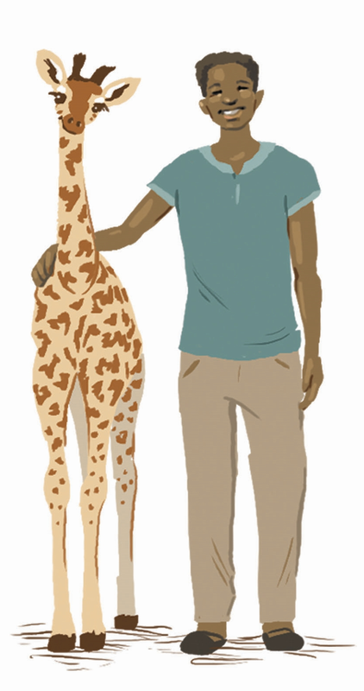
Gilberto is as tall as a giraffe
You have
31/50
Mystic Mics
We know that Gilberto isn’t really as tall as a giraffe…
But…
we are saying it to overexaggerate our point so that everyone knows how tall Gilberto actually is!

Slide 151
You have
31/50
Mystic Mics
Overexaggerate
To overexaggerate is to exaggerate, which means to make something much bigger, better or worse than it actually is.
For example: I’m so hungry I can eat an elephant! This is an over exaggeration explaining how hungry I am. Could I actually eat an elephant? No
Or could I….

Slide 152
You have
31/50
Mystic Mics
Remember
Similes are easy to find!
You need to remember that there are two words that you should look for to identify a simile, those words are…
Like
As

Slide 153
You have
31/50
Mystic Mics
Have a look at the similes that are going to appear.
Your task is to click on the word that shows us that it is a simile!

Slide 154
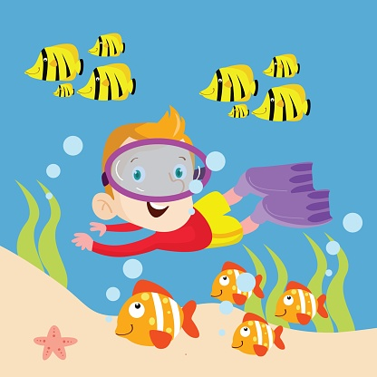
You have
31/50
Mystic Mics
Click on the word that shows us that this is a simile.
The boy swims like a fish

Slide 155
You have
31/50
Mystic Mics
Well done! The answer is ‘like’ because the boy isn’t a fish, but his swimming ability is being compared to a fish.
The boy swims like a fish

Slide 156
You have
31/50
Mystic Mics
How about this one…

Slide 157
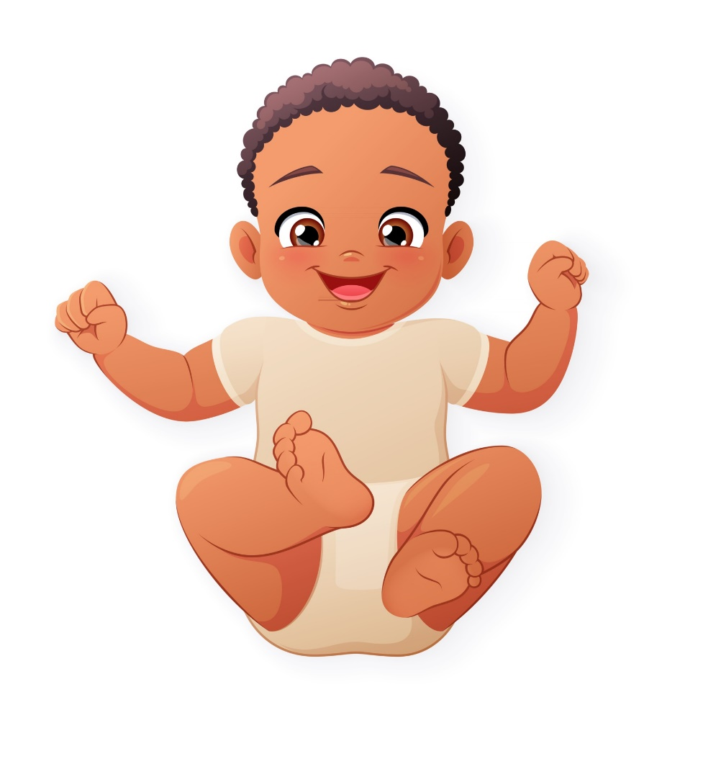
You have
31/50
Mystic Mics
Click on the word that shows us that this is a simile.
The baby is as sweet as honey

Slide 158
You have
31/50
Mystic Mics
Well done! The answer is ‘as’ because the baby is being compared to something that tastes sweet which is honey.
The baby is as sweet as honey

Slide 159
You have
31/50
Mystic Mics
How about this one…

Slide 160

You have
31/50
Mystic Mics
Click on the word that shows us that this is a simile.
Naomi is as fast as lightning

Slide 161
You have
31/50
Mystic Mics
Well done! The answer is ‘as’ because Naomi is being compared to lightning, which she clearly isn’t faster than.
Naomi is as fast as lightning

Slide 162
Well done!
You learnt what a simile is
You have just obtained a Mystic Mic!

Slide 163
You have
/50
Mystic Mics
32

Slide 164
Right now I am feeling
1 2 3 4 5 6 7 8 9 10
Slide the cursor to show how you currently feel.

Slide 165
You have
32/50
Mystic Mics
Let’s play a game to test your simile knowledge!

Slide 166
You have
32/50
Mystic Mics
5 images are going to appear on the screen
You will see one half of the simile
You need to drag and drop the other part of the simile to make the whole simile make sense

Slide 167
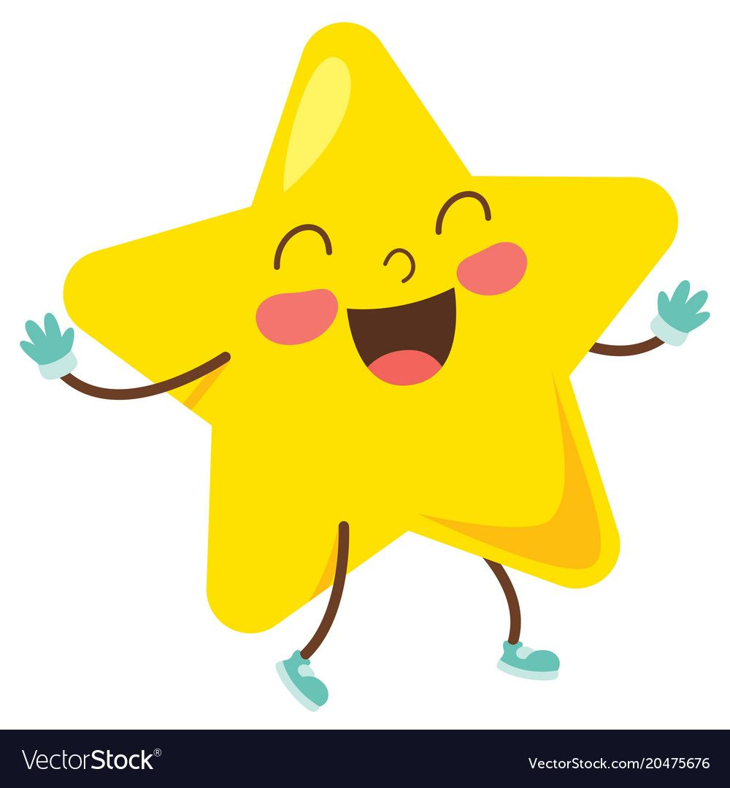
You have
32/50
Mystic Mics
Drag and drop the correct ending to the simile
As shiny ______________
like a computer
as a star
as a teacher
as a computer

Slide 168
You have
32/50
Mystic Mics
As shiny as a star

Slide 169

You have
32/50
Mystic Mics
Drag and drop the correct ending to the simile
As soft ______________
as a coconut
like person
as a pillow
like pillow

Slide 170
You have
32/50
Mystic Mics
As soft as a pillow

Slide 171
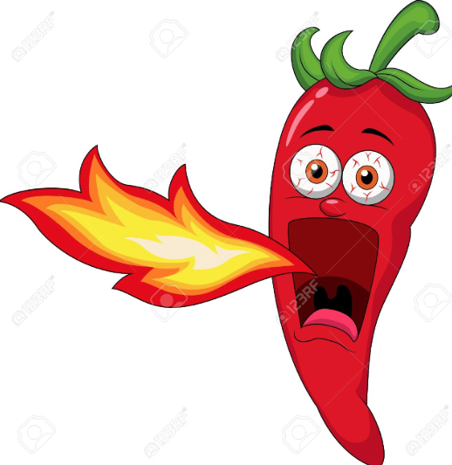
You have
32/50
Mystic Mics
Drag and drop the correct ending to the simile
Hot ______________
like a chilli
as the sky
because of chillies
like dirt

Slide 172
You have
32/50
Mystic Mics
Hot like a chilli

Slide 173
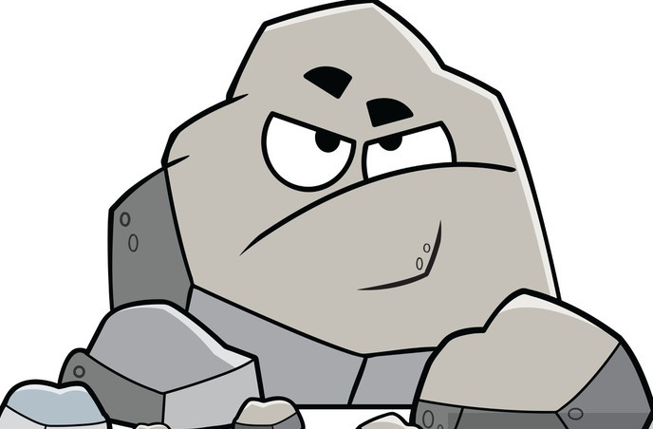
You have
32/50
Mystic Mics
Drag and drop the correct ending to the simile
______________ a rock
As angry as
As hard as
#
As happy as a
Soft like a

Slide 174
You have
32/50
Mystic Mics
As hard as a rock

Slide 175
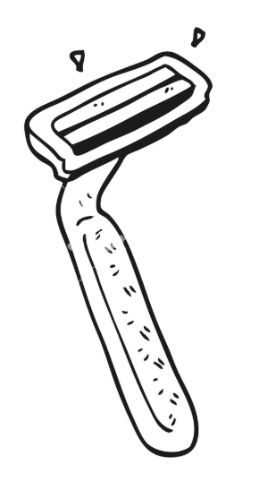
You have
32/50
Mystic Mics
Drag and drop the correct ending to the simile
Sharp _____________
like the iron
like a razor
#
as a person shaving
like a gorilla

Slide 176
You have
32/50
Mystic Mics
Sharp like a razor

Slide 177
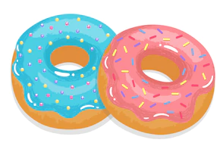
You have
32/50
Mystic Mics
Drag and drop the correct ending to the simile
_____________ a donut
Crazy like
Sharp like
As sweet as
As painful like

Slide 178
You have
32/50
Mystic Mics
As sweet as a donut

Slide 179
Well done!
You completed the simile challenge
You have obtained 5 Mystic Mics from Rapping Rabbit
You have
32/50
Mystic Mics

Slide 180
Well done!
You have obtained 5 Mystic Mics from Rapping Rabbit
You have
32/50
Mystic Mics

Slide 181
You have
/50
Mystic Mics
37

Slide 182
Right now I am feeling
1 2 3 4 5 6 7 8 9 10
Slide the cursor to show how you currently feel.

Slide 183
You have
37/50
Mystic Mics
Challenge time!
This challenge will win you three Mystic Mics

Slide 184
Type an 8 bar rap using the words at the end of the lines
You have
37/50
Mystic Mics
_________________________________
_________________________________
_________________________________
_________________________________
_________________________________
_________________________________
_________________________________
_________________________________
right
fight
clear
fear
tear
ear
sight
light

Slide 185
Well done!
You have just obtained three Mystic Mics!

Slide 186
You have
/50
Mystic Mics
40

Slide 187
You have
40/50
Mystic Mics
This is the section where you become a superstar rapper!

Slide 188
You have
40/50
Mystic Mics
Your task will be to write about the emotions that appear using a specific rhyme scheme

Slide 189
Pick an emotion to write a rap about.
Happy
Proud
Sad
Excited
Angry

Slide 190
Happy
You have
40/50
Mystic Mics
Use the AAAA rhyme scheme to write this rap
_________________________________
_________________________________
_________________________________
_________________________________
_________________________________
_________________________________
_________________________________
_________________________________
Now rap the lyrics to the instrumental
great
create
late
debate
smile
style
mile
while

Slide 191
Happy
You have
40/50
Mystic Mics
Now write your own rap about being happy using any rhyme scheme you like!
_________________________________
_________________________________
_________________________________
_________________________________
_________________________________
_________________________________
_________________________________
_________________________________

Slide 192
Happy
You have
40/50
Mystic Mics
_________________________________
_________________________________
_________________________________
_________________________________
_________________________________
_________________________________
_________________________________
_________________________________
Rap your lyrics along to the instrumental

Slide 193
Right now I am feeling
1 2 3 4 5 6 7 8 9 10
Slide the cursor to show how you currently feel.

Slide 194
Well done!
You have just obtained a Mystic Mic!

Slide 195
You have
/50
Mystic Mics
41

Slide 196
Pick an emotion to write a rap about.
Happy
Proud
Sad
Excited
Angry

Slide 197
Proud
You have
41/50
Mystic Mics
Use the AABB rhyme scheme to write this rap
_________________________________
_________________________________
_________________________________
_________________________________
_________________________________
_________________________________
_________________________________
_________________________________
Now rap the lyrics to the instrumental
crowd
proud
rap
snap
superstar
car
story
glory

Slide 198
Proud
You have
41/50
Mystic Mics
Now write your own rap about being proud using any rhyme scheme you like!
_________________________________
_________________________________
_________________________________
_________________________________
_________________________________
_________________________________
_________________________________
_________________________________

Slide 199
Proud
You have
41/50
Mystic Mics
_________________________________
_________________________________
_________________________________
_________________________________
_________________________________
_________________________________
_________________________________
_________________________________
Rap your lyrics along to the instrumental

Slide 200
Right now I am feeling
1 2 3 4 5 6 7 8 9 10
Slide the cursor to show how you currently feel.

Slide 201
Well done!
You have just obtained a Mystic Mic!

Slide 202
You have
/50
Mystic Mics
42

Slide 203
Pick an emotion to write a rap about.
Happy
Proud
Sad
Excited
Angry

Slide 204
You have
42/50
Mystic Mics
Let’s see if you can continue the challenge writing raps without the words being coloured!

Slide 205
Sad
You have
42/50
Mystic Mics
Use the ABAB rhyme scheme to write this rap
_________________________________
_________________________________
_________________________________
_________________________________
_________________________________
_________________________________
_________________________________
_________________________________
Now rap the lyrics to the instrumental
sad
rain
down
wrong
glad
pain
clown
song

Slide 206
Sad
You have
42/50
Mystic Mics
Now write your own rap about being sad using any rhyme scheme you like!
_________________________________
_________________________________
_________________________________
_________________________________
_________________________________
_________________________________
_________________________________
_________________________________

Slide 207
Sad
You have
42/50
Mystic Mics
_________________________________
_________________________________
_________________________________
_________________________________
_________________________________
_________________________________
_________________________________
_________________________________
Rap your lyrics along to the instrumental

Slide 208
Right now I am feeling
1 2 3 4 5 6 7 8 9 10
Slide the cursor to show how you currently feel.

Slide 209
Well done!
You have just obtained a Mystic Mic!

Slide 210
You have
/50
Mystic Mics
43

Slide 211
Pick an emotion to write a rap about.
Happy
Proud
Sad
Excited
Angry

Slide 212
Excited
You have
43/50
Mystic Mics
Use the AAAA rhyme scheme to write this rap
_________________________________
_________________________________
_________________________________
_________________________________
_________________________________
_________________________________
_________________________________
_________________________________
Now rap the lyrics to the instrumental
excited
delighted
united
provided
dream
team
supreme
scream

Slide 213
Excited
You have
43/50
Mystic Mics
Now write your own rap about being excited using any rhyme scheme you like!
_________________________________
_________________________________
_________________________________
_________________________________
_________________________________
_________________________________
_________________________________
_________________________________

Slide 214
Excited
You have
43/50
Mystic Mics
_________________________________
_________________________________
_________________________________
_________________________________
_________________________________
_________________________________
_________________________________
_________________________________
Rap your lyrics along to the instrumental

Slide 215
Right now I am feeling
1 2 3 4 5 6 7 8 9 10
Slide the cursor to show how you currently feel.

Slide 216
Well done!
You have just obtained a Mystic Mic!

Slide 217
You have
/50
Mystic Mics
44

Slide 218
Pick an emotion to write a rap about.
Happy
Proud
Sad
Excited
Angry

Slide 219
Angry
You have
44/50
Mystic Mics
Use the AABB rhyme scheme to write this rap
_________________________________
_________________________________
_________________________________
_________________________________
_________________________________
_________________________________
_________________________________
_________________________________
Now rap the lyrics to the instrumental
angry
smart
fire
mood
cranky
heart
desire
food

Slide 220
Angry
You have
44/50
Mystic Mics
Now write your own rap about being angry using any rhyme scheme you like!
_________________________________
_________________________________
_________________________________
_________________________________
_________________________________
_________________________________
_________________________________
_________________________________

Slide 221
Angry
You have
44/50
Mystic Mics
_________________________________
_________________________________
_________________________________
_________________________________
_________________________________
_________________________________
_________________________________
_________________________________
Rap your lyrics along to the instrumental

Slide 222
Right now I am feeling
1 2 3 4 5 6 7 8 9 10
Slide the cursor to show how you currently feel.

Slide 223
Well done!
You have just obtained a Mystic Mic!

Slide 224
You have
/50
Mystic Mics
45

Slide 225
You have
45/50
Mystic Mics
We’re almost there! 5 Mystic Mics to go!
Oh no…
It’s Mic Menace and he’s coming to steal the microphones!

Slide 226
You have
45/50
Mystic Mics
HA HA HA
You don’t deserve these Mystic Mics! Let me take some of them off of your hands…

Slide 227

HA HA HA
HA HA HA
HA HA HA
HA HA HA
HA HA HA
HA HA HA
HA HA HA
HA HA HA
HA HA HA
HA HA HA
You have
/50
Mystic Mics
HA HA HA
45
HA HA HA
HA HA HA
HA HA HA
HA HA HA
HA HA HA

Slide 228
You have
/50
Mystic Mics
40

Slide 229
You have
40/50
Mystic Mics
The only way you can get these back is if you beat me in a rap battle…
And no one has ever beaten me!

Slide 230
Right now I am feeling
1 2 3 4 5 6 7 8 9 10
Slide the cursor to show how you currently feel.

Slide 231
You have
40/50
Mystic Mics
Oh no!
Mic Menace just challenged you to a rap battle.
I think we’re going to need some help from Rapping Rabbit

Slide 232
You have
40/50
Mystic Mics
Did you call for my help?
Let me explain to you how the rap battle will work and then we can do some practice.

Slide 233
You have
40/50
Mystic Mics
Don’t you worry…
I’ve been in plenty of rap battles and they’re very intense.
Here is what you have to do…

Slide 234
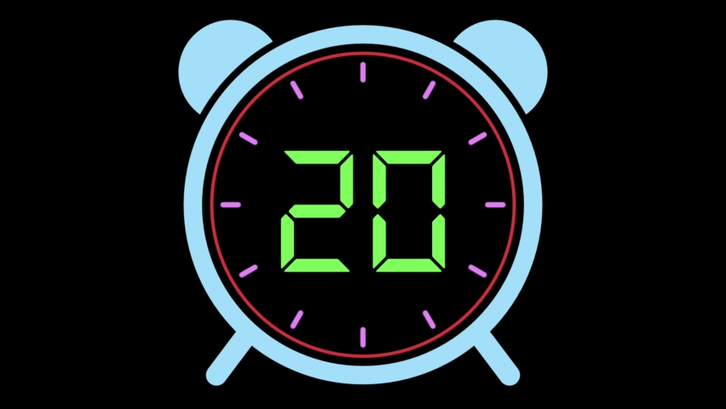
You have
40/50
Mystic Mics
There will be a timer on the screen that looks like this
You need to pay attention to the timer!

Slide 235
You have
40/50
Mystic Mics
When Mic Menace says a line, you must type a line that rhymes with his line, but don’t worry, I will give you some words to help.
You will have 20 seconds to write your line otherwise you will lose and will have to restart!

Slide 236
You have
40/50
Mystic Mics
Let’s give it a shot…

Slide 237
You have
40/50
Mystic Mics
I’m sitting in my chair
fair
bear
care

Slide 238
You have
40/50
Mystic Mics
I went outside
glide
wide
hide

Slide 239
You have
40/50
Mystic Mics
Then I went to the shop
stop
pop
drop

Slide 240
You have
40/50
Mystic Mics
I love me some sweets
beats
heat
street

Slide 241
You have
40/50
Mystic Mics
I always feel alive
drive
arrive
surprise

Slide 242
You have
40/50
Mystic Mics
Wow, you’re pretty good at battling…
I think you’re ready to take on Mic Menace!
But before I go, I think you deserve to have this…

Slide 243
Well done!
You have obtained 5 Mystic Mics from Rapping Rabbit
You have
40/50
Mystic Mics

Slide 244
Well done!
You have obtained 5 Mystic Mics from Rapping Rabbit
You have
40/50
Mystic Mics

Slide 245
You have
/50
Mystic Mics
45

Slide 246
Right now I am feeling
1 2 3 4 5 6 7 8 9 10
Slide the cursor to show how you currently feel.

Slide 247
You have
45/50
Mystic Mics
Ha…
I see Rapping Rabbit has done some practice with you – but I am much harder, and you have to beat me if you want to get these microphones back!

Slide 248
You have
45/50
Mystic Mics
Before we start, I just want to make a few adjustments….

Slide 249
You have
45/50
Mystic Mics
Let me make some adjustments to the timer!

Slide 250
You have
45/50
Mystic Mics

Slide 251
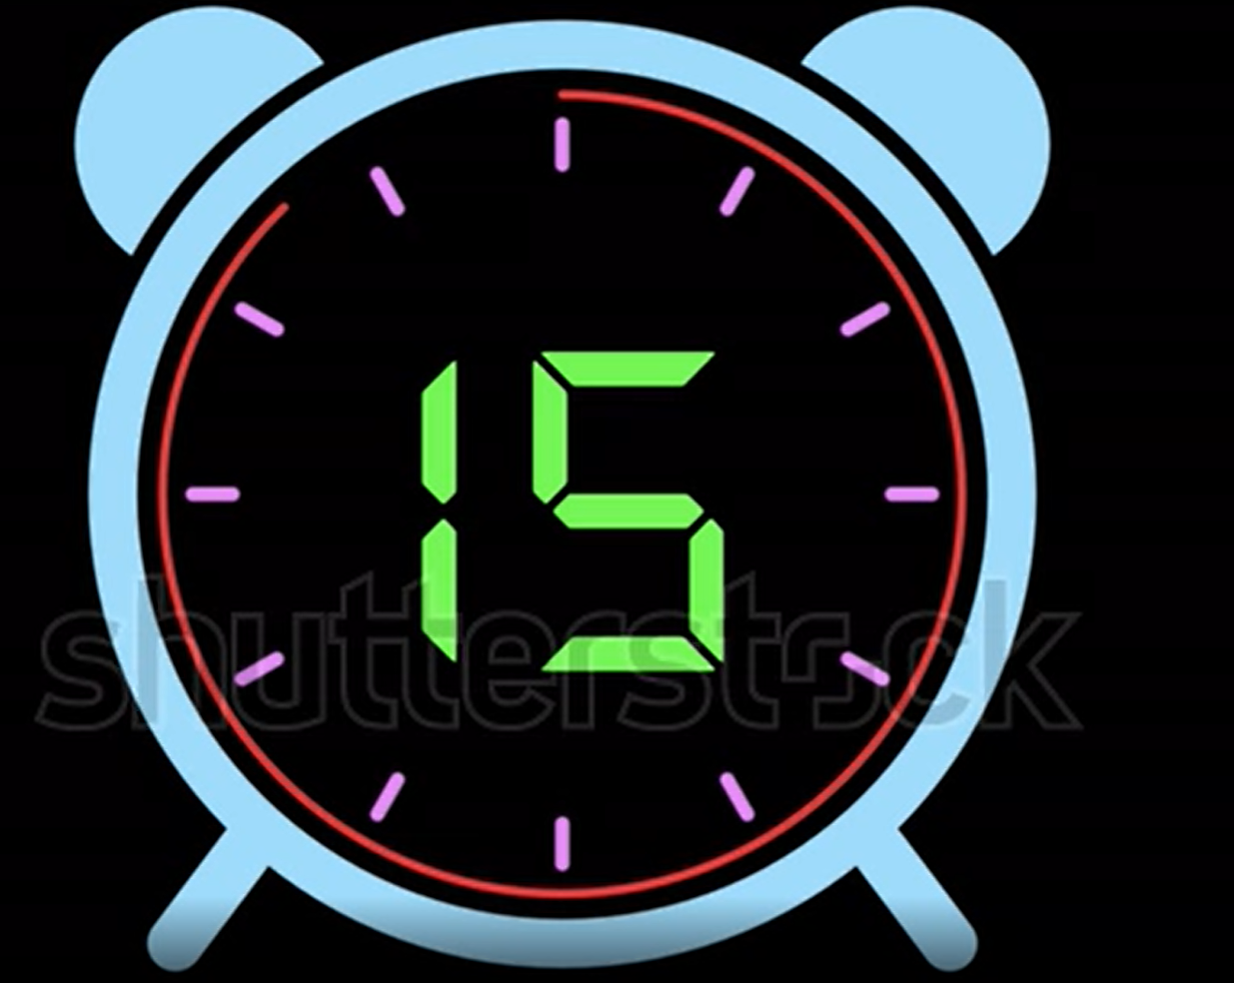
You have
45/50
Mystic Mics

Slide 252
You have
45/50
Mystic Mics
You can’t rap like me
tree
free
disagree

Slide 253
You have
45/50
Mystic Mics
I’m the best rapper alive
guys
shy
deprive

Slide 254
You have
45/50
Mystic Mics
I got the best bars
cars
Mars
stars

Slide 255
You have
45/50
Mystic Mics
I’m as strong as a gorilla
thriller
Godzilla
bigger

Slide 256
You have
45/50
Mystic Mics
I’m fire on the beat
heat
sweet
neat

Slide 257
You have
45/50
Mystic Mics
I’m on top like a mountain’s peak
weak
geek
speak

Slide 258
You have
45/50
Mystic Mics
I’m the greatest around
found
ground
crowned

Slide 259
You have
45/50
Mystic Mics
You won’t win the battle
cattle
rattle
paddle

Slide 260
You have
45/50
Mystic Mics
I will steal everything you own
alone
home
unknown

Slide 261
You have
45/50
Mystic Mics
I will be gone, I will vanish
banish
Spanish
damage

Slide 262
You have
45/50
Mystic Mics
Oh no…
You were able to beat me…
Ah!

Slide 263
You have
45/50
Mystic Mics
I guess a deal is a deal
Here are your Mystic Mics back
I will get you next time!

Slide 264
You have
/50
Mystic Mics
50

Slide 265
Right now I am feeling
1 2 3 4 5 6 7 8 9 10
Slide the cursor to show how you currently feel.

Slide 266
You have
50/50
Mystic Mics
Wow, you have become a master rapper.
You have obtained all 50 Mystic Mics
But just before you go…

Slide 267
You have
50/50
Mystic Mics
I would like you to write one more rap and after you write this rap, make sure you wait for the next page so you can download your certificate and see what I suggest you write about in your own time!

Slide 268
Right now I am feeling
1 2 3 4 5 6 7 8 9 10
Slide the cursor to show how you currently feel.

Slide 269
I often feel
You have
42/50
Mystic Mics
Write a rap titled “I often feel”. Make sure you write how you feel! Aim for 16 bars.
_________________________________
_________________________________
_________________________________
_________________________________
_________________________________
_________________________________
_________________________________
_________________________________
_________________________________
_________________________________
_________________________________
_________________________________
_________________________________
_________________________________
_________________________________
_________________________________

Slide 270
Right now I am feeling
1 2 3 4 5 6 7 8 9 10
Slide the cursor to show how you currently feel.

Slide 271
You have
50/50
Mystic Mics
Before you download your certificate, have a look at some writing ideas that you can write about in your own time to keep practicing your rap skills!
Positive thoughts
A letter to my future self
I will be a good friend
I can and I will dream big
Bullies aren’t cool
Keep my head down and focus
We’re all human let’s get along
The pressures of life
A story of my life
I will love myself
Click here to download your certificate

Slide 273
You have
50/50
Mystic Mics
Oh no! You got 3/5 correct.
Click here to try again

